Slide 1
CONSTRAINTS AND VOILATION

Slide 2
What are Database Constraints in DBMS ??
Database constraints are restrictions on the contents of the database or on database operations. It is a condition specified on a database schema that restricts the data to be inserted in an instance of the database.
Need of Constraints :
Constraints in the database provide a way to guarantee that :
the values of individual columns are valid.
in a table, rows have a valid primary key or unique key values.
in a dependent table, rows have valid foreign key values that reference rows in a parent table.

Slide 3
Different Types of constraints in DBMS :
Domain Constraints
Tuple Uniqueness Constraints
Key Constraints
Single Value Constraints
Integrity Rule 1 (Entity Integrity Rule or Constraint)
Integrity Rule 2 (Referential Integrity Rule or Constraint)
General Constraints

Slide 4
Domain Constraints –
Domain Constraints specifies that what set of values an attribute can take. Value of each attribute X must be an atomic value from the domain of X. The data type associated with domains include integer, character, string, date, time, currency etc. An attribute value must be available in the corresponding domain. Consider the example below –

Slide 5
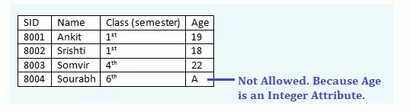

Slide 6
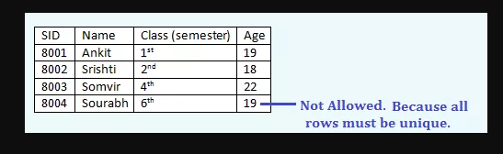
Tuple Uniqueness Constraints –
A relation is defined as a set of tuples. All tuples or all rows in a relation must be unique or distinct. Suppose if in a relation, tuple uniqueness constraint is applied, then all the rows of that table must be unique i.e. it does not contain the duplicate values.

Slide 7
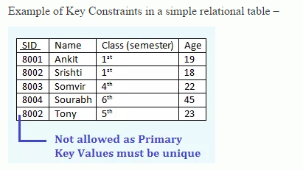
Key Constraints –
Keys are attributes or sets of attributes that uniquely identify an entity within its entity set. An Entity set E can have multiple keys out of which one key will be designated as the primary key. Primary Key must have unique and not null values in the relational table. In an subclass hierarchy, only the root entity set has a key or primary key and that primary key must serve as the key for all entities in the hierarchy.

Slide 8
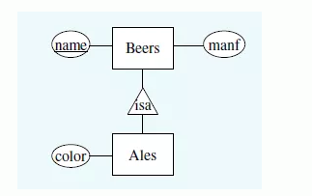
Example of Key Constraints in an subclass hierarchy –

Slide 9
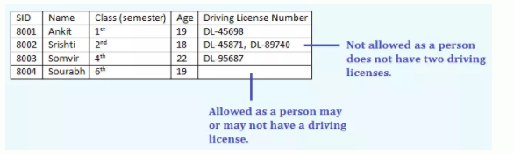
Single Value Constraints –
Single value constraints refers that each attribute of an entity set has a single value. If the value of an attribute is missing in a tuple, then we cal fill it with a “null” value. The null value for a attribute will specify that either the value is not known or the value is not applicable. Consider the below example-

Slide 10
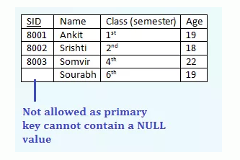
Integrity Rule 1 (Entity Integrity Rule or Constraint) –
The Integrity Rule 1 is also called Entity Integrity Rule or Constraint. This rule states that no attribute of primary key will contain a null value. If a relation have a null value in the primary key attribute, then uniqueness property of the primary key cannot be maintained. Consider the example below-

Slide 11
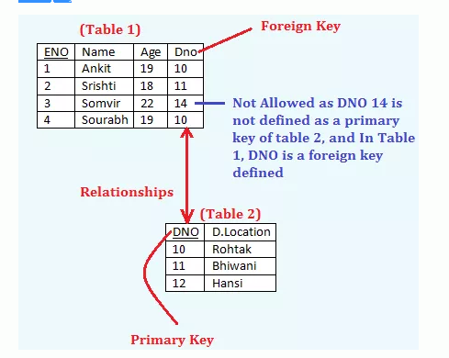
Integrity Rule 2 (Referential Integrity Rule or Constraint) –
The integrity Rule 2 is also called the Referential Integrity Constraints. This rule states that if a foreign key in Table 1 refers to the Primary Key of Table 2, then every value of the Foreign Key in Table 1 must be null or be available in Table 2. For example,

Slide 12
Some more Features of Foreign Key
Records cannot be inserted into a Foreign table if corresponding records in the master table do not exist.
Records of the master table or Primary Table cannot be deleted or updated if corresponding records in the detail table actually exist.
General Constraints –
it.specify more general constraints like the CHECK Constraints or the Range Constraints etc.
Check constraints can ensure that only specific values are allowed in certain column. For example , if there is a need to allow only three values for the color like ‘Bakers Chocolate’, ‘Glistening Grey’ and ‘Superior White’, then we can apply the check constraint. All other values like ‘GREEN’ etc would yield error Range Constraints is implemented by BETWEEN and NOT BETWEEN. For example, if it is a requirement that student ages be within 16 to 35, then we can apply the range constraints for

Slide 13
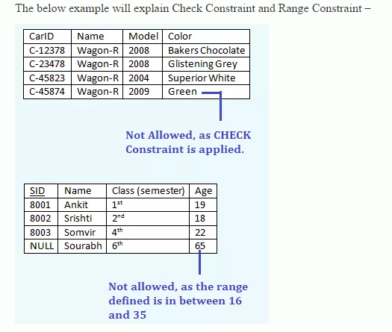

Slide 14
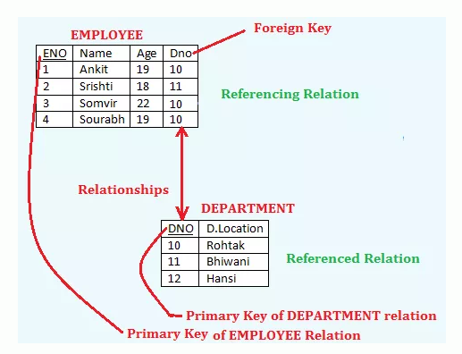
Constraint Violations in DBMS

Slide 15
Here, ENO is a Primary Key and DNO is a Foreign Key in EMPLOYEE relation.
Table that contain candidate key is called referenced relation and
The table containing foreign key is called referencing relation.
So, the relation DEPARTMENT is a referenced relation and
The relation EMPLOYEE is a referencing relation.

Slide 16
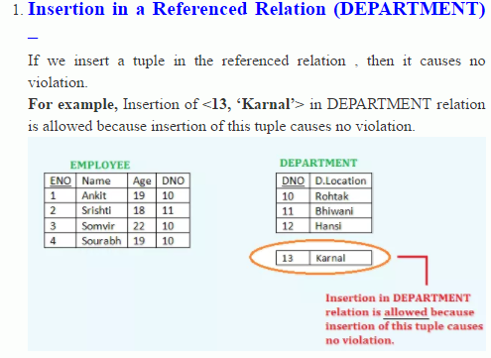
The Insert Operation :

Slide 17
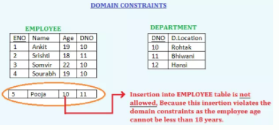
Insertion in a Referencing Relation (EMPLOYEE) – The insert operation in a referencing relation can violate any of four types of constraints –
DomainConstraints – Insertion of the value <5, ‘Pooja’, 10, 11> into EMPLOYEE table is not allowed, Because this insertion violates the domain constraints as the employee age cannot be less than 18 years.

Slide 18
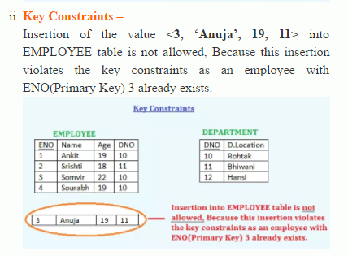

Slide 19
